Slide 1

DEPARTMENT OF COMPUTER SCIENCE AND ELECTRONICS ENGINEERING
INTERNET BEAMING HOT AIR BALLOON
(LOON PROJECT)
PRESENTED BY:
DEEP SHIKHA
PRACHI SINGH

Slide 2
CONTENTS
INTRODUCTION
CONSTRUCTION
CONNECTIVITY
WORKING
ADVANTAGES
DISADVANTAGES
FUTURE SCOPES
CONCLUSION

Slide 3
INTRODUCTION
Project Loon is a research and development project to providing internet in rural and remote areas where the internet connectivity is like impossible.
Loon balloons travel twice as much as supplying airlines, 20 kilometers above the earth, and they work as a Network of floating cell towers.
Loon balloons are just cell towers that movement, following the currents of wind, and your phone would change to the nearest one just as it does to the stationary tower.

Slide 4
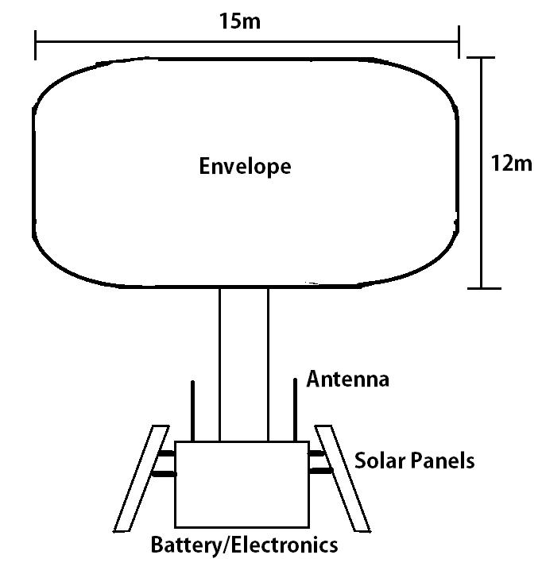
CONSTRUCTION

Slide 5
CONSTRUCTION
Envelope: polyethylene plastic 15 meters wide and 12 meters tall when fully inflated
Solar panels: To provide energy to on board equipment
Radio antenna: To communicate with other balloons in the network
LTE antenna: To generate coverage network
Lithium-ion battery: To store energy from solar panels
Parachute: To safely lower balloon
Gas cylinder: To control the balloons altitude

Slide 6
CONNECTIVITY
Each balloon can offer connectivity to a terrain location of approximately 40 km in diameter at a pace corresponding to the 3G.
The locations of the balloons are tracked as every balloon is geared up with a GPS.
Balloon use antennas geared up with Radio frequency era.
Radio transceivers are for use.
i. Globe to balloon communications.
ii. Globe to ground conversation.
iii. Third for backup.

Slide 7
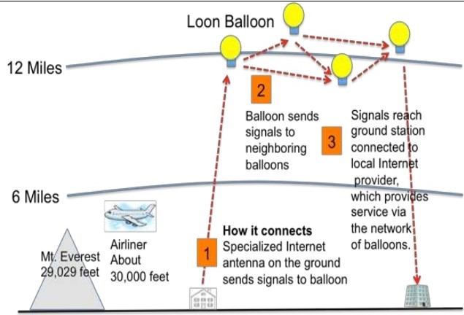
WORKING

Slide 8
ADVANTAGES
While using this device, the net connection will be for all people inside the world.
This loon gadget will provide web to all human being, no matter its location.
The Loon mission may be transmitted textual content, audio, video and applications for any Wi-Fi.

Slide 9
DISADVANTAGES
It has probability of hardware failure.
There is no internet privacy.
Not a replacement of satellite communication.
It became a hot topic to International politics

Slide 10
FUTURE SCOPES
It would be able to decrease the dependencies of user’s in hardware.
All the people can access the internet.
People in rural areas , in deserts area or in flooded areas where the internet is not available due to some reasons, the internet would be available with speed by Internet beaming hot air balloons.

Slide 11
CONCLUSION
Internet beaming hot air balloon is a way to convey internet to everybody in the world.
It is able to connect everyone through internet inspite of natural disasters.

Slide 12
THANK YOU

